Slide 1
Computer Organization and Architecture Exp 2 Serial Adder & Parallel Adder
Notes:
OK,now it’s the second experiment of our class, this experiment’s topic is SAPA.

Slide 2
Preface
Experiment Purpose
(1) Understand the sturcture of serial and parallel adder;
(2) Know the principle and implementation of arithmetic shift register;
Experiment content
Design 4-bit signed serial adder and parallel adder with same inputs, and compare the resuts of them.

Slide 3
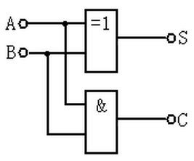
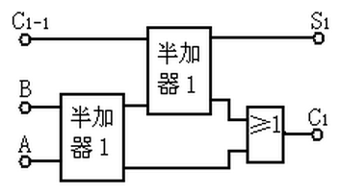
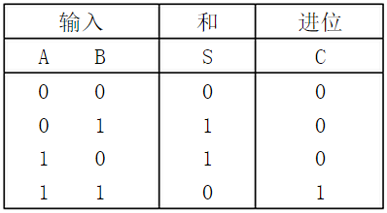
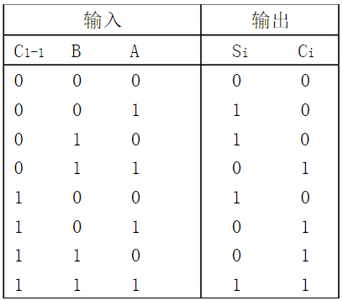
1 Understanding
HA(Half-Adder) FA(Full-Adder)
S_{i} = A_{i}⊕ B_{i}⊕C_{i}
C_{i+1}=A_{i}·B_{i}+(A_{i} ⊕B_{i})·C_{i}
HA
HA
Input
Sum
Carry
Input
Output
Notes:
At first , we need to understand the principle of HA & FA. (Small pause) the HA has 2 inputs of A & B

Slide 4
2.1Design for Serial-Adder
OF
F_{n-1}
F_{n-2}
……
F₁
F₀
C_{n-2}
C₂
C₁
C₀
C_{n}
FA
FA
FA
FA
C_{n-1}
B’_{n-1}
B’_{n-2}
B’₁
B’₀
M=0Add
M=1Sub
…………
Op-control M
B_{n-1}
A_{n-1}
B_{n-2}
A_{n-2}
……
B₁
A₁
B₀
A₀
Sign bit
[A]_{补}=A_{n-1}A_{n-2}…A₁A₀ [B]_{补}=B_{n-1}B_{n-2}…B₁B₀
F_{i} = A_{i}⊕ B_{i}⊕C_{i} C_{i+1}=A_{i}·B_{i}+(A_{i} ⊕B_{i})·C_{i}
A_{n-1} and B_{n-1} are sign bits ，Overflow Flag：OF ＝ C_{n} ⊕ C_{n-1}
Notes:
补码的加法计算器

Slide 5
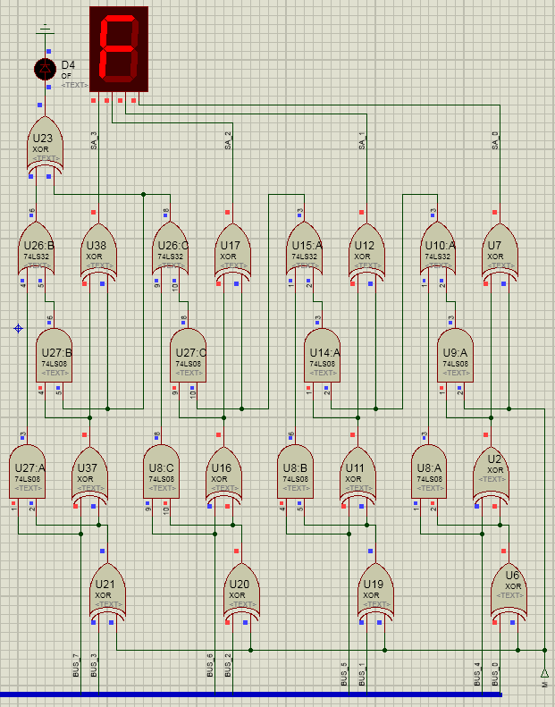
[A]_{补}=A_{n-1}A_{n-2}…A₁A₀ [B]_{补}=B_{n-1}B_{n-2}…B₁B₀
F_{i} = A_{i}⊕ B_{i}⊕C_{i} C_{i+1}=A_{i}·B_{i}+(A_{i} ⊕B_{i})·C_{i}
C_{i+1}=A_{i}·B_{i}+(A_{i} ⊕B_{i})·C_{i}
F_{i} = A_{i}⊕ B_{i}⊕C_{i}
(A_{i} ⊕B_{i})·C_{i}
A_{i}·B_{i}
A_{i}⊕ B_{i}
[B]_{补}=B_{n-1}B_{n-2}…B₁B₀
A_{n-1}A_{n-2}…A₁A₀ B_{n-1}B_{n-2}…B₁B₀
Notes:
减去一个数，等于加上这个数的补码（减去一个数，等于加上他的相反数的补码）
负数的补码等于原码取反加一（符号位不取反）， m=1,B经xor取反，并加上1(即m)得其补码

Slide 6
2.2 Design for Parallel-Adder
Ci+1 =Ai ·Bi + (Ai ⊕Bi )·Ci
Let Yn= An·Bn Xn= (An⊕Bn)
Yn is the carry bit generation function of 4-bit carry addition chains.
Xn is the carry bit transition function of 4-bit carry addition chains.
C_{n+1}=Yn+XnC_{n}
C1=Y0+X0C0
C2=Y1+X1C1 =Y1+X1Y0 +X1X0C0
C3=Y2+X2C2=Y2+X2Y1 +X2X1Y0 +X2X1X0C0
C4=Y3+X3C3=Y3+X3Y2 +X3X2Y1 +X3X2X1Y0 +X3X2X1X0C0

Slide 7
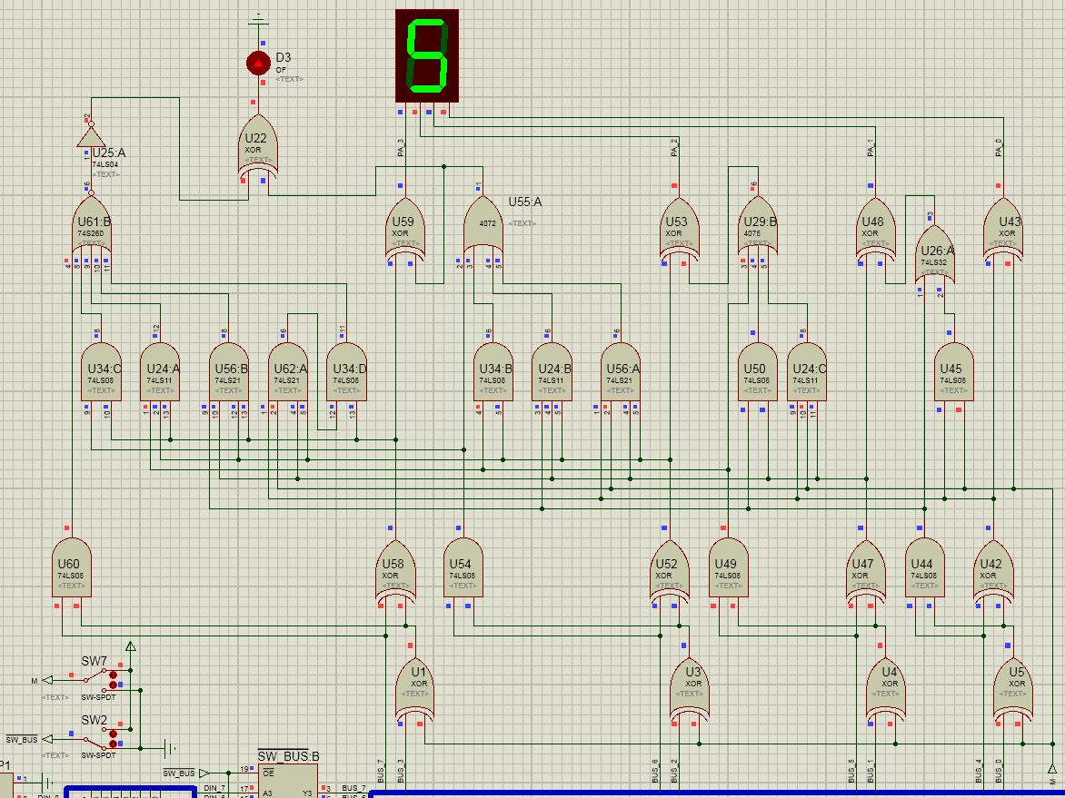
C3=Y2+X2C2
=Y2+X2Y1 +
X2X1Y0 +X2X1X0C0
C1=Y0+X0C0
C2=Y1+X1C1
=Y1+X1Y0 +X1X0C0
C4=Y3+X3C3
=Y3+X3Y2 +X3X2Y1
+X3X2X1Y0 +X3X2X1X0C0
Notes:
最高位得进位输出不等于最高位得进位输入，则发生溢出

Slide 8
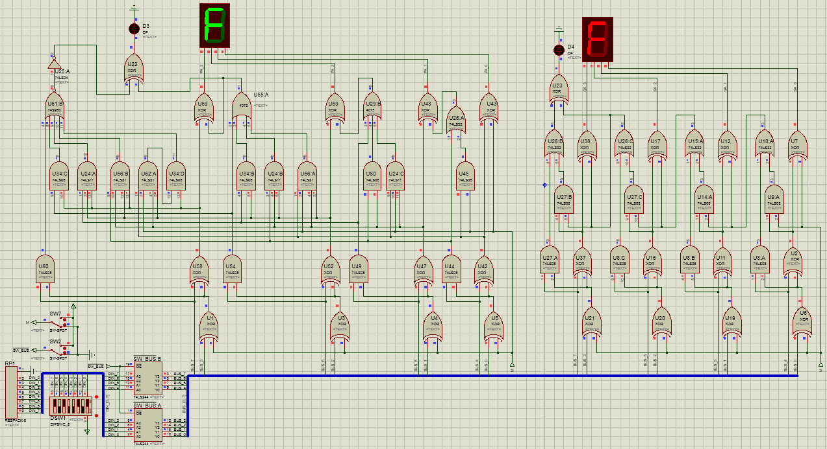
The whole diagram
You can find it in our experiment pdf file

Slide 9
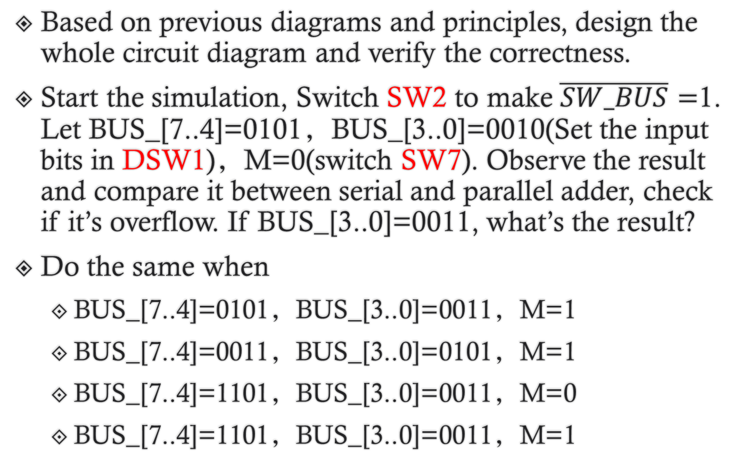
3.Experiment Steps
Based on previous diagrams and principles, design the whole circuit diagram and verify the correctness.
Start the simulation, Switch SW2 to make $\overline{SW_BUS}=$1. Let BUS_[7..4]=0101，BUS_[3..0]=0010(Set the input bits in DSW1)，M=0(switch SW7). Observe the result and compare it between serial and parallel adder, check if it’s overflow. If BUS_[3..0]=0011, what’s the result?
Do the same when
BUS_[7..4]=0101，BUS_[3..0]=0011，M=1
BUS_[7..4]=0011，BUS_[3..0]=0101，M=1
BUS_[7..4]=1101，BUS_[3..0]=0011，M=0
BUS_[7..4]=1101，BUS_[3..0]=0011，M=1

Slide 10
Questions
1. Is this experimental ALU original form or 2’s complement form? Assume we want to modify the circuit into unsigned 4-bit original form ALU, what we need to do?
2. In this experiment, what’s the range of the 4-bit 2’s complement code? If we want to modify it into 5-bit 2’s complement ALU(1 bit for sign bit, 4 bits for numbers), how does the range change? How to modify it?

